Slide 1
Definition of a differentiable Loss Function for Text Simplification Tasks
Text Simplification Project
Rebekah Cramerus
Malte Klingenberg
Paul Opuchlich

Slide 2






Agenda
Problem
Approach
Feature Selection
Dataset
Experiments
Next Steps

Slide 3
Problem
Approach
Feature Selection
Dataset
Experiments
Next Steps

Slide 4



Problem
Text
Simplicity
Notes:
Not continuous. Neural network!!,

Slide 5
Problem
Text
Simplicity
not differentiable
Notes:
Not continuous. Neural network!!,

Slide 6
Problem
POS
Frequency
not differentiable
Synonyms
Simplicity
Subordination
Abbreviations
…
Notes:
Not continuous. Neural network!!,

Slide 7
Problem
Approach
Feature Selection
Dataset
Experiments
Next Steps

Slide 8

Approach
Text
Simplicity

Slide 9
Approach
76
Text

Slide 10
Approach
76
Text
65

Slide 11
Approach
76
Text
65

Slide 12


Approach
Linguistic Features
Experiments
Weighting
Scoring
Notes:
Just give the neural network the text and see if it is predicting our manually calculated scores

Slide 13
Approach
Linguistic Features
Experiments
Weighting
Scoring
It includes 16 constituent states, covers an area of 357,021 square kilometres, and has a largely temperate seasonal climate.
76
The total area of Germany is 357,021 square kilometres. The large majority of Germany has warm summers and cold winters.
48
Wikipedia and Simple Wikipedia
Notes:
Just give the neural network the text and see if it is predicting our manually calculated scores

Slide 14
Problem
Approach
Feature Selection
Dataset
Experiments
Next Steps

Slide 15
Feature Selection
Lexical
Hiebert, E. H. (2002). Standards, assessment, and text difficulty.
Syntactic
Aluisio, S., Specia, L., Gasperin, C., & Scarton, C. (2010, June). Readability assessment for text simplification.
Semantic
Siddharthan, A. (2006). Syntactic simplification and text cohesion.
…
Notes:
Lexical
Word Length Mean
Only together with word difficulty useful
Flesch-Kinkaid, Dale-Chall
Word-Frequency
Basic English, Non-Basic-English
Syntax
Sentence Length
Sentence Parts
Passive Voice
Nominalization
Embeddedness
Aposition
Relative Clauses
Adverbial phrases
Coordination
Subordination
Semantic
Discourse Parsing
Number of arguments etc.

Slide 16



Feature Selection
Lexical
Mean Word Length
Syntactic
Flesch Index
Semantic
Word Frequency
Notes:
Lexical
Word Length Mean
Only together with word difficulty useful
Flesch-Kinkaid, Dale-Chall
Word-Frequency
Basic English, Non-Basic-English
Syntax
Sentence Length
Sentence Parts
Passive Voice
Nominalization
Embeddedness
Aposition
Relative Clauses
Adverbial phrases
Coordination
Subordination
Semantic
Discourse Parsing
Number of arguments etc.

Slide 17


Feature Selection
Lexical
Sentence Length
Syntactic
Passive
Nominalization
Embeddedness
Relative Clauses
Sentence Parts
Semantic
Coordination
Subordination
Notes:
Lexical
Word Length Mean
Only together with word difficulty useful
Flesch-Kinkaid, Dale-Chall
Word-Frequency
Basic English, Non-Basic-English
Syntax
Sentence Length
Sentence Parts
Passive Voice
Nominalization
Embeddedness
Aposition
Relative Clauses
Adverbial phrases
Coordination
Subordination
Semantic
Discourse Parsing
Number of arguments etc.

Slide 18



Feature Selection
Lexical
Sentence Length
Discourse Relations
Syntactic
Sentence Parts
Coherence
Semantic
Coordination
Subordination
Cohesion
Notes:
Lexical
Word Length Mean
Only together with word difficulty useful
Flesch-Kinkaid, Dale-Chall
Word-Frequency
Basic English, Non-Basic-English
Syntax
Sentence Length
Sentence Parts
Passive Voice
Nominalization
Embeddedness
Aposition
Relative Clauses
Adverbial phrases
Coordination
Subordination
Semantic
Discourse Parsing
Number of arguments etc.

Slide 19
Problem
Approach
Feature Selection
Dataset
Experiments
Next Steps

Slide 20





Dataset
Simple Wikipedia
Newsela
News in Levels
Children’s Books
Penn Treebank
Notes:
Newsela – Experts rewrite actual stories in different complexity levels

Slide 21



Dataset
News
Experts
Levels
Newsela

Slide 22
Dataset
Shakaria is a 5-month-old puppy.
She lives in Kenya's Maasai Mara.
Kenya is a country in East Africa.
Maasai Mara is a protected area full of animals.
Shakaria is usually playful.
She gets serious about her job, though.
Five-month-old bloodhound Shakaria gambols through the long savannah grasses of Kenya's Maasai Mara reserve, her playful mood swiftly turning to keen determination as she is ordered to track a human scent.

Slide 23
Dataset
Shakaria is a 5-month-old puppy.
She lives in Kenya's Maasai Mara.
Kenya is a country in East Africa.
Maasai Mara is a protected area full of animals.
Shakaria is usually playful.
She gets serious about her job, though.
Feature | Normal | Simple
Sentences | 1 | 6
Words per Sentence | 33 | 6,6
Mean Word Length | 5,58 | 4,9
Not basic English | 0,75 | 0,72
Syllables per Word | 1,6 | 1,425
…
Five-month-old bloodhound Shakaria gambols through the long savannah grasses of Kenya's Maasai Mara reserve, her playful mood swiftly turning to keen determination as she is ordered to track a human scent.

Slide 24
Problem
Approach
Feature Selection
Dataset
Experiments
Next Steps

Slide 25
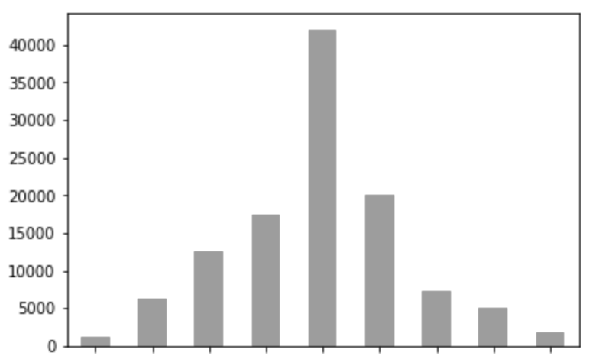
Experiments
Ratio between Sentence Lengths
0,0
0,8-1,0
(same length)
1,8

Slide 26
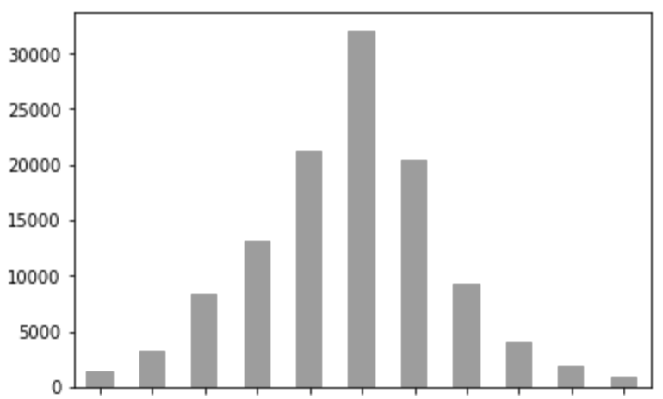
Experiments
Ratio between Sentence Lengths
Ratio between Word Mean Length
0,0
0,8-1,0
(same length)
1,8
0,75
0,95-1,0
(same length)
1,25

Slide 27
Experiments

Slide 28
Experiments
Word Rank
Log
Sum
Mean
Geoffrey Leech, Paul Rayson, and Andrew Wilson (2001)
Notes:
Word Lemmatize Corpus → Log the rank of the words → sum up the difficulty score for text → mean to get difficutly per word (unknown words are assigned with a high number (9))

Slide 29
Experiments
Words
Count
Log
Sum

Slide 30
Problem
Approach
Feature Selection
Dataset
Experiments
Next Steps

Slide 31



Next steps
New Features / Datasets
Ensembling
Scoring
Training
Cooperation

Slide 32
Thank you

Slide 33
Thank you

